Slide 1
NETWORK MODELING FINAL PROJECT
Jaswanth Das Gunturu
Prakhar Gupta
Sudhanshu Shekhar

Slide 2
INTRODUCTION
The objective of this project was to maximize the total fare revenue collected by our car.
A number of network datasets were provided. Each dataset represents a distinct city or metro area.
For each network dataset, several random instances were generated.

Slide 3
INSTANCES OVERVIEW
The dataset contained instances which looked like this:
timeOfRequest, startVertex, endVertex, fareOffered, threshholdDistance
Example:
132, 8, 10, 12.87, 4.5
This line means “132 seconds into the driving session, a user demands a ride from vertex 8 to vertex 10. The ride offers $12.87 of revenue. Your driver will be offered the ride if he/she is within distance 4.5 minutes driving time to the origin location, vertex 8, and is not currently driving another rider.”

Slide 4
DECISION VARIABLES
Each time a ride becomes available and the car is close enough to the origin vertex to be offered the ride, a decision must be made to accept or reject the ride.
Each time a car becomes idle at the end of a ride, a decision about relocating towards a higher demand area must be made.

Slide 5
FACTORS TAKEN INTO CONSIDERATION
maxPickUpProbabilty: Higher, the better
driverDensityAtLocations: Lower, the better
my_AvgFareMultiplier: Higher, the better
my_distance: Lower, the better

Slide 6
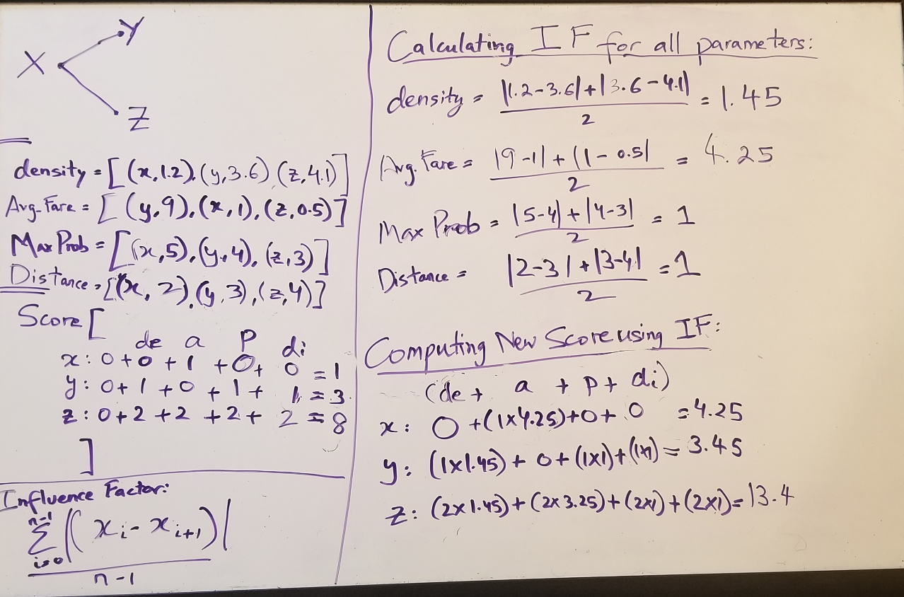
LOGIC BEHIND RELOCATION FUNCTION

Slide 7
LOGIC BEHIND RIDE DECISION FUNCTION
We added a threshold of $35, what this does is, if any request is generated for a fare less than this, the ride is always rejected
This actually helps as the requests generated are random and not realistic, so we actually have a much greater probability to get a better paying ride if we are already at an optimal location.
This helps improve average revenue generated considerably.

Slide 8
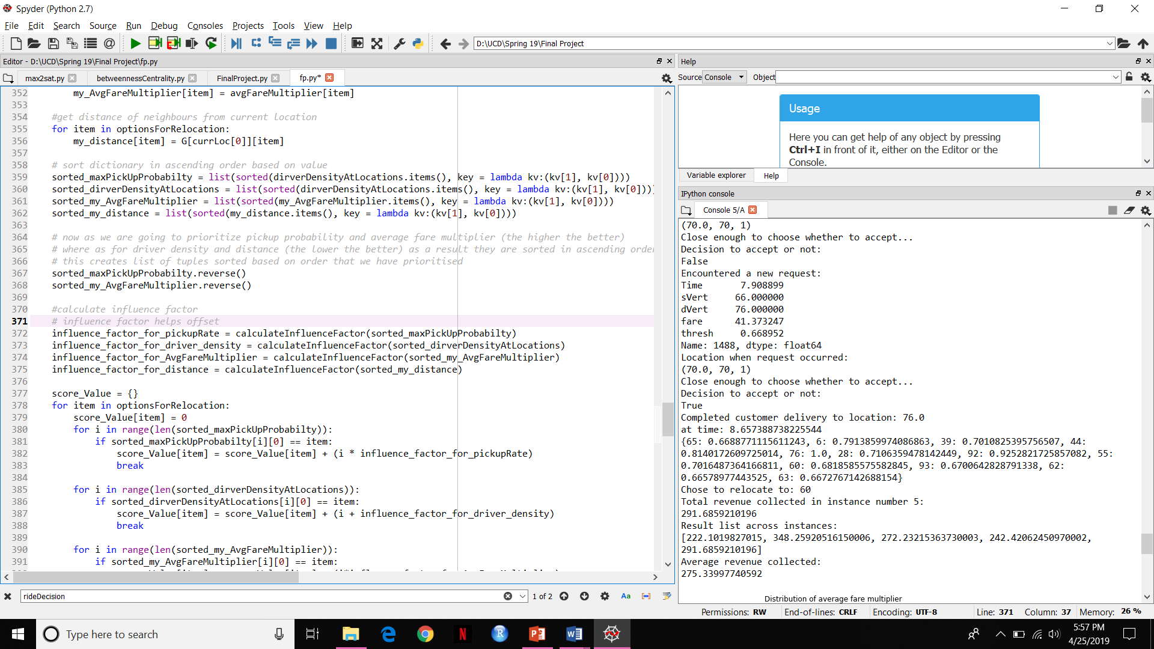
FINAL OUTPUT SAMPLE

Slide 9
THANK YOU

